Slide 1
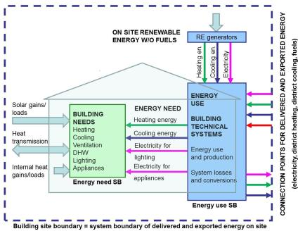
Methodology for calculation of energy performance of buildings
Directive on the energy performance of buildings (EPBD):
2002/91/EC
2010/31/EU (recast)
2018/844/EU (amendment)

Slide 2
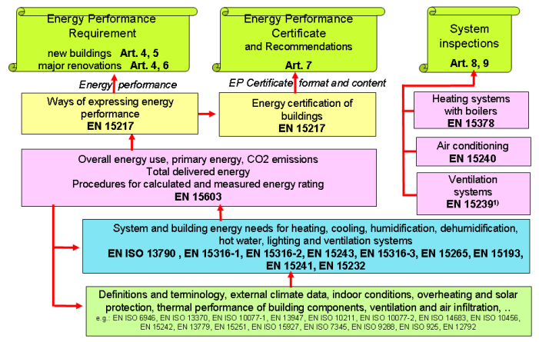
EPBD (2002/91/EC, 2010/31/EU): Overview of standards
EN ISO 13790:2008
Energy performance of building – Calculation of energy use for space heating and cooling

Slide 3
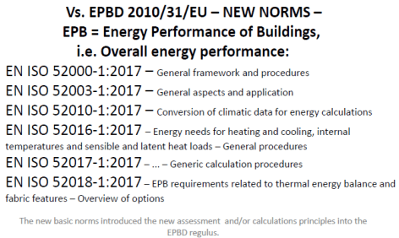
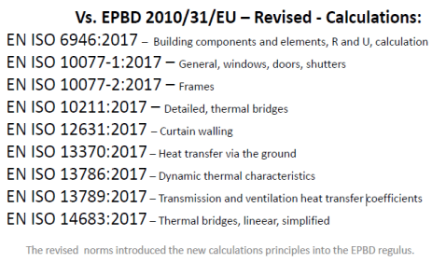
Directive 2018/844/EU: Changes in EPBD standards

Slide 4
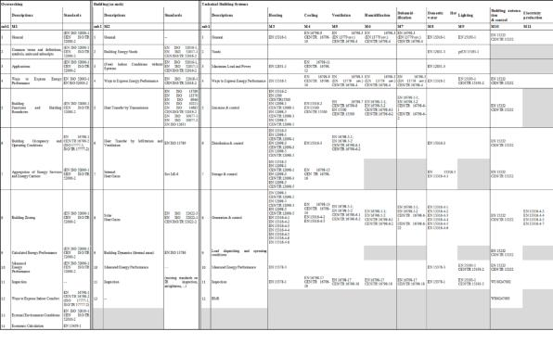
Directive 2018/844/EU: Changes in EPBD standards
100 standards in 11 modules

Slide 5
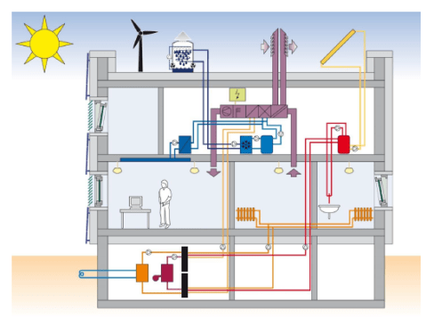
DIN V 18599
DIN V 18599 - Energy efficiency of buildings – Calculation of the net, final and primary energy demand for heating, cooling, ventilation, domestic hot water and lighting

Slide 6
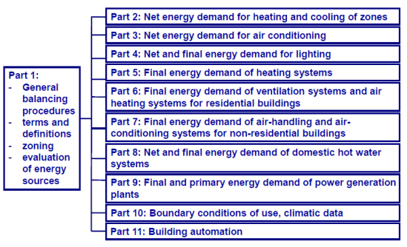
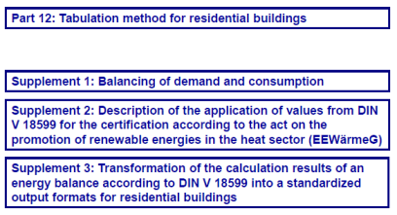
DIN V 18599

Slide 7
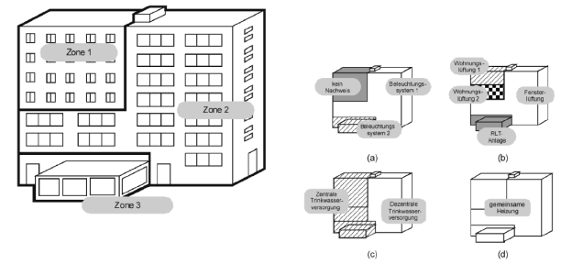
DIN V 18599: Zoning of building

Slide 8
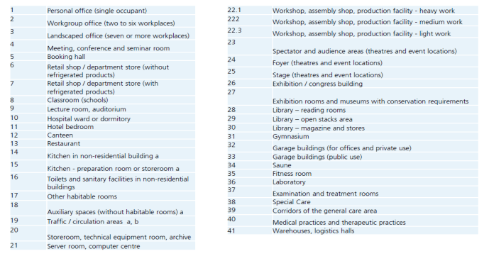
DIN V 18599: User profiles

Slide 9
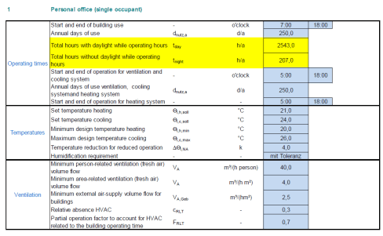
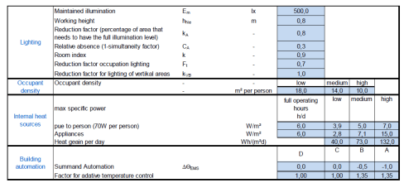
DIN V 18599: User profiles

Slide 10
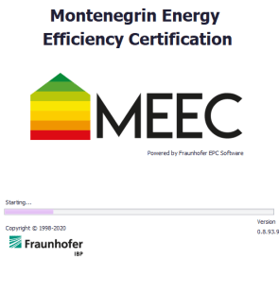
Software MEEC (Montenegrin Energy Efficiency Certification)

Slide 11
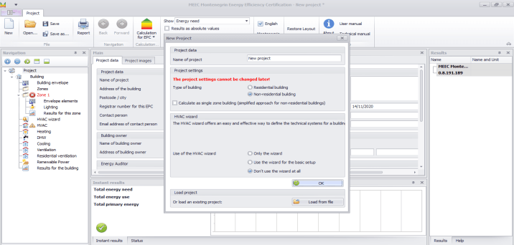
MEEC: Main concepts
Zone approach
Multi-zone approach (non-residential)
Single-zone approach (residential and non-residential)
HVAC system
HVAC wizard (simplified approach)
HVAC wizard but developing more details
Detailed description (no HVAC wizard use)

Slide 12
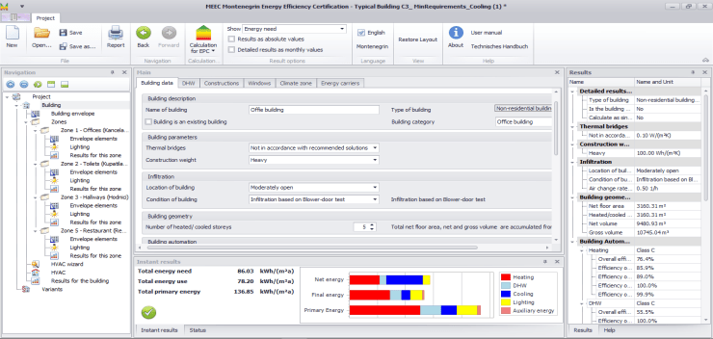
MEEC: User interface
Main area
Navigation tree
Help / Parameters results
Instant results

Slide 13
MEEC: Menu structure
Two modes
Certification
Consultation mode/ Energy audits

Slide 14
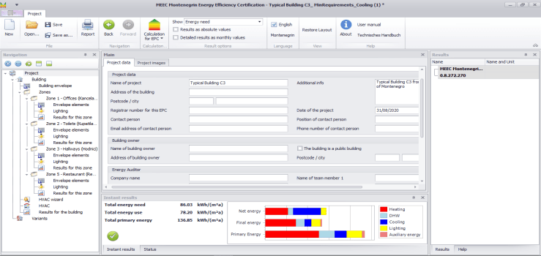
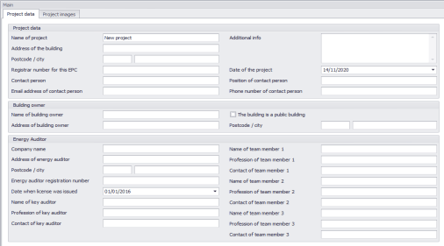
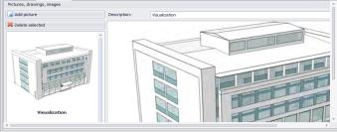
STEP 1: Definition of project data, energy auditors, etc.

Slide 15
STEP 2: Definition of building data (1)
Building parameters in line with Rulebook on minimum energy efficiency requirements in buildings (methodology)

Slide 16
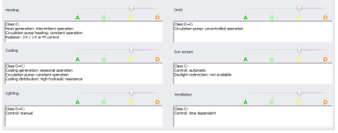
STEP 2: Definition of building data (2)
Automation levels of building systems described in 4 classes, A to D

Slide 17
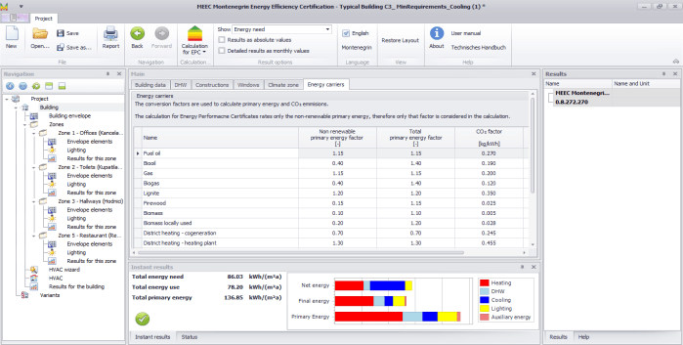
STEP 2: Definition of building data (3)
DHW demands
List of all user defined constructions
List of windows used in the project
Conversion factors
Climate data

Slide 18
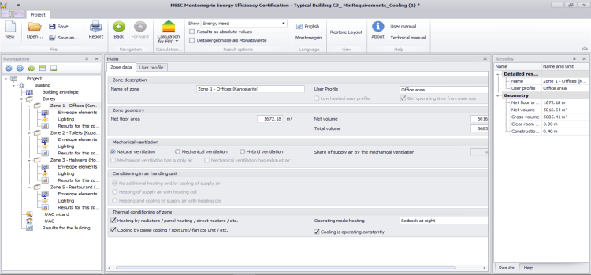
STEP 3: Definition of building zones (in case of multi-zone approach) (1)
Single zone approach:
13 user profiles defined for building types specified in the Rulebook
Multi zone approach:
36 user profiles defined for different zones (consistent with profiles for building types)

Slide 19
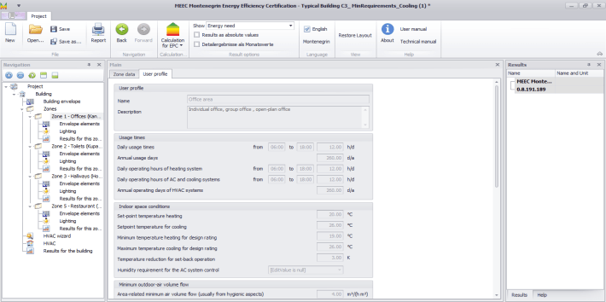
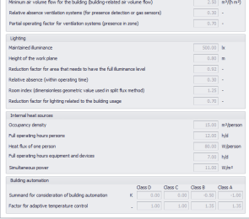
STEP 3: Definition of building zones (in case of multi-zone approach) (2)
Certification mode:
User profile data are “locked”.
Consultation/energy audit mode:
User profile data can be modified.

Slide 20
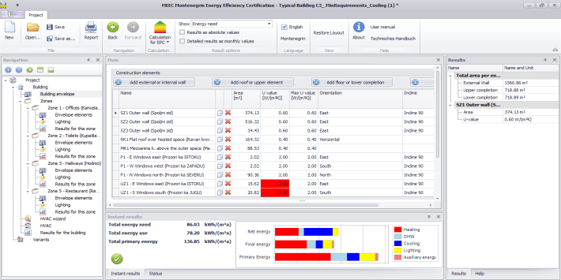
STEP 4: Definition of building envelope elements (1)
U-values exceeding the minimum requirements from the Rulebook are marked in red

Slide 21
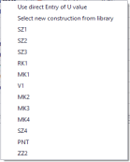
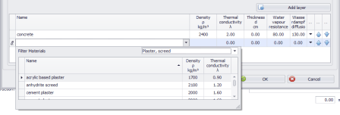
STEP 4: Definition of building envelope elements (2)
Opaque envelope elements
Direct U-values entry
Definition of construction layers

Slide 22
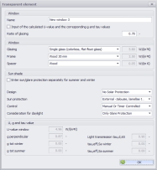
STEP 4: Definition of building envelope elements (3)
Transparent envelope elements
Direct U-value entry (and corresponding g and tau values)
Definition of window elements (glazing, frame, spacer)
+ definition of sun protection system

Slide 23
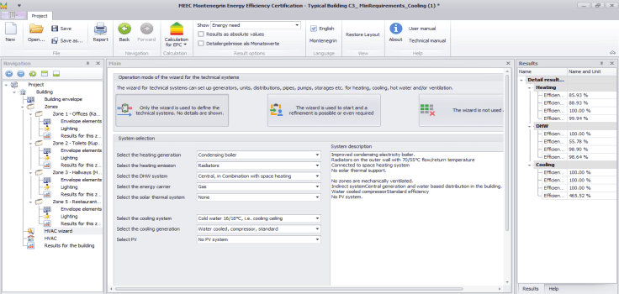
STEP 5: Definition of technical systems in building (1)
If only HVAC wizard is used no entries in the navigation tree are shown (default values for the selected systems)

Slide 24
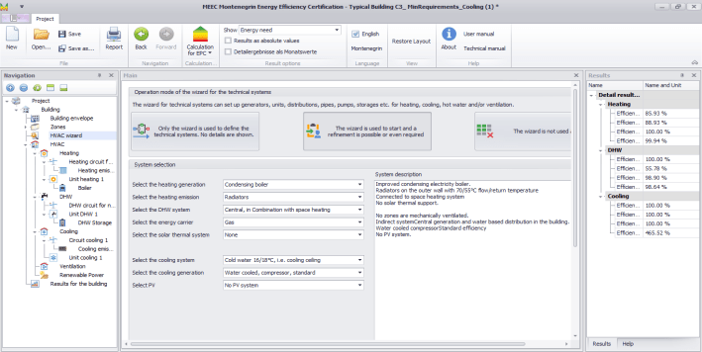
STEP 5: Definition of technical systems in building (2)
If HVAC wizard is used to start but with refinement possibilities, the details of the HVAC systems can be seen in the navigation tree and changes can be made

Slide 25
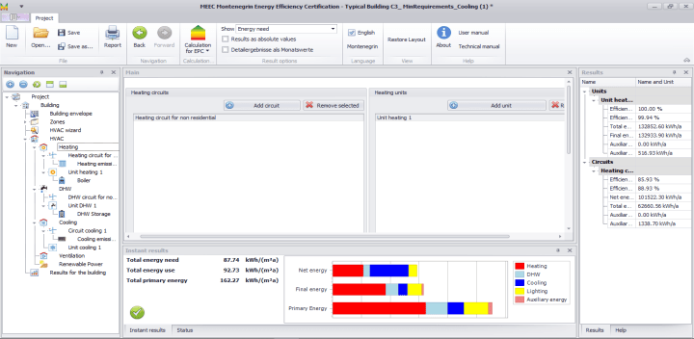
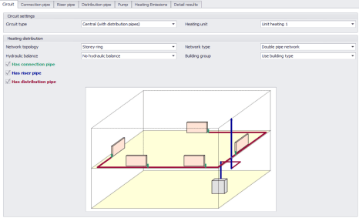
STEP 5: Definition of technical systems in building (3)

Slide 26
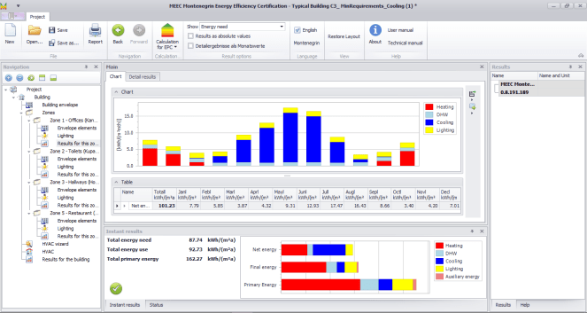
STEP 6: Display of the results

Slide 27
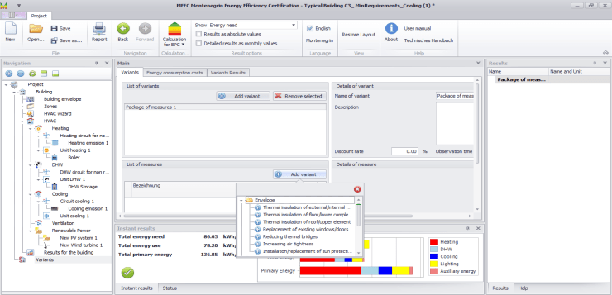
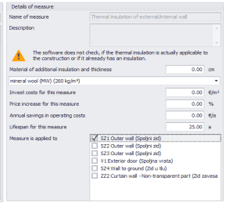
STEP 7: Definition of measures to improve energy efficiency of the building
EE measures:
Envelope
Lighting
HVAC – Heating
HVAC – DHW
HVAC – Cooling
HVAC – Ventilation
Power generation

Slide 28
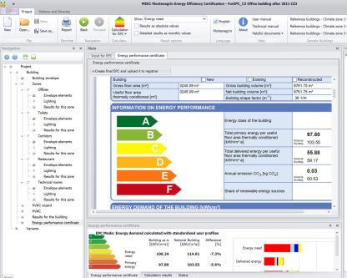
STEP 8: Generation of energy performance certificate (EPC)
* Calculation for EPC mode

