Slide 1
Phase 4: Activities after the site visit
After visiting the site, the auditor needs to examine all the data obtained from the activities during the preparation and building survey phases, upon which he/she:
identifies places of inefficient energy consumption and
proposes energy efficiency-improving measures,
which together with measures analysis are presented in an energy audit report.

Slide 2
Step 7 Analysis of the collected data
Immediately after the site visit, the auditor needs to interpret his/her records and fill in the data in the checklists they did not have time to complete during the survey.
In addition, all the drawings, sketches, and schemes made during the survey should be organized, together with completed checklists and photo documentation, by categories (external envelope/heating system/ventilation/DHW preparation/cooling/lighting/different consumers) for better understanding the technical and energy properties of the building and further data analysis

Slide 3
Analysis of thermal characteristics of the building’s external envelope
Analysis of energy characteristics of the heating system
Analysis of energy characteristics of the air conditioning and cooling systems
Analysis of energy characteristics of the system for preparation of domestic hot water
Analysis of energy characteristics of the electricity appliances/consumers
Analysis of energy characteristics of the systems for producing thermal and electrical energy from alternative energy systems
Calculating the amount of thermal energy required for heating
Analysis of domestic water consumption

Slide 4
Step 7 Analysis of the collected data
>>> SOFTWARE FOR ENERGY PERFORMANCE CALCULATION
>>> CALCULATION

Slide 5
Step 8 Selecting appropriate measures for increasing energy efficiency of individual energy systems
As part of this analysis, it is necessary to identify and propose adequate measures that can be divided into 3 groups:
Energy efficiency measures aimed at saving energy and/or water while maintaining or improving comfort conditions that result in savings in energy and/or water consumption, energy and/or water costs, and reducing greenhouse gas emissions;
Economic efficiency measures are aimed at saving money, although they do not result in energy savings;
Measures aimed at increasing the degree of comfort and fulfilling the minimum technical conditions defined by regulations and rulebooks that may result in increased energy and/or water consumption and do not necessarily represent energy and economic efficiency measures.

Slide 6
Step 8 Selecting appropriate measures for increasing energy efficiency of individual energy systems
Each type of building, depending on its purpose, has some specific features of its energy systems that are crucial for understanding the whole building’s functioning concept.

Slide 7
EE Measures: Building’s envelope
Thermal insulation of external walls
This measure is always implemented when external walls are without any thermal protection. Savings by introducing this measure can range from 15-25%. In addition to thermal protection, this measure prevents the negative consequences of cold bridges and significantly improves the indoor comfort.

Slide 8
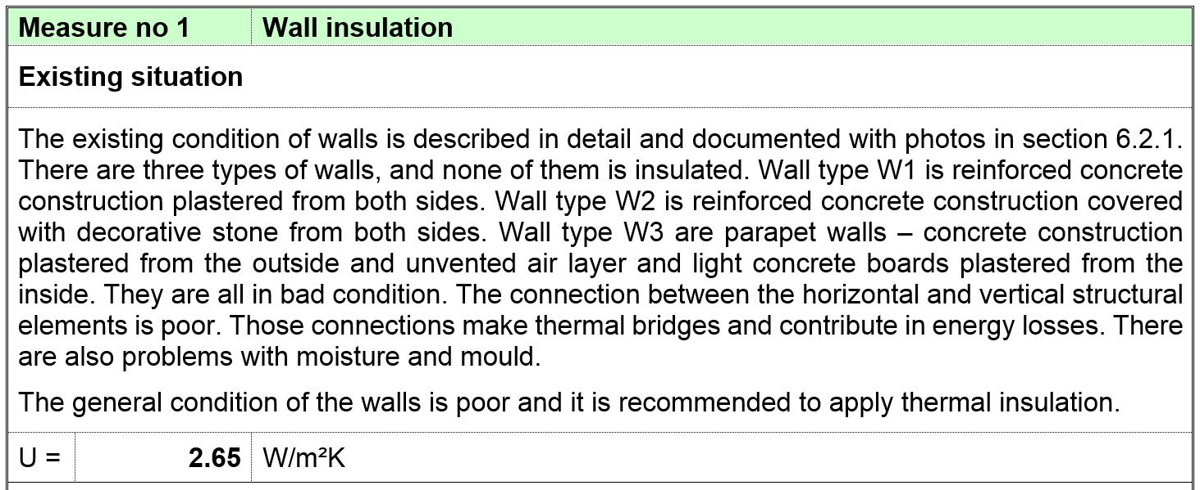
example: Thermal insulation of external wall or a wall adjacent to an unheated space

Slide 9
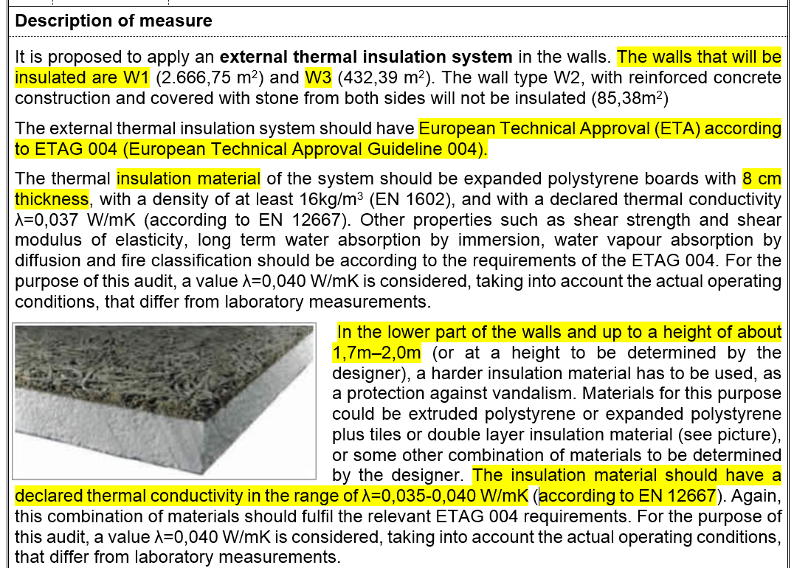
POSTITION
STANDARD
TYPE OF INSULATION
DESCRIPTION
DRAWINGS/IMAGES
THERMAL CHARACTERISTICS

Slide 10
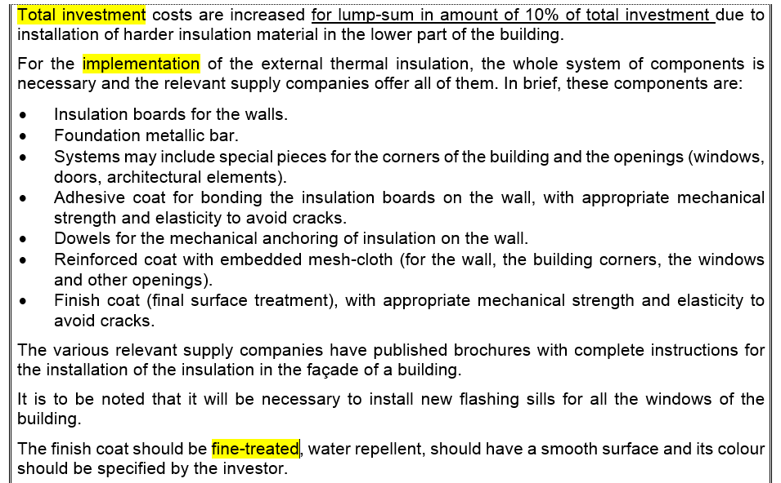
INVESTMENT
IMPLEMENTATION
SYSTEM / LIST OF COMPONENTS
MAINTENANCE

Slide 11
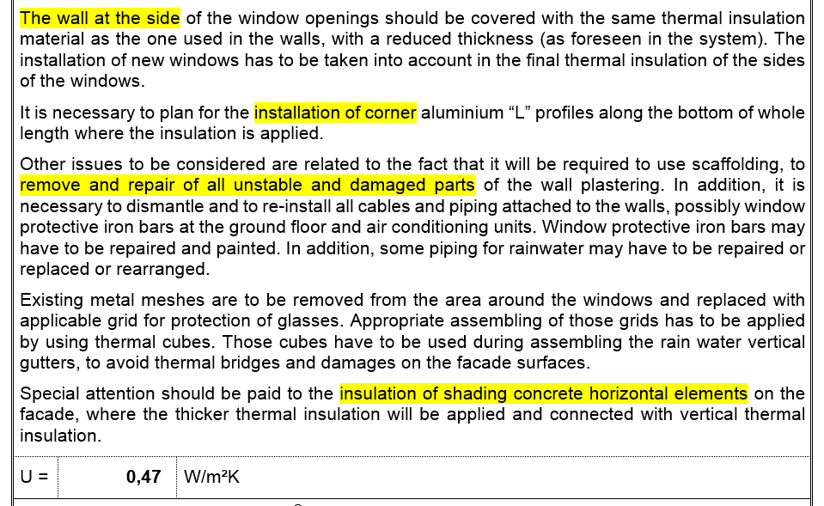
INSTALATION - NOTES
NEW U VALUE

Slide 12
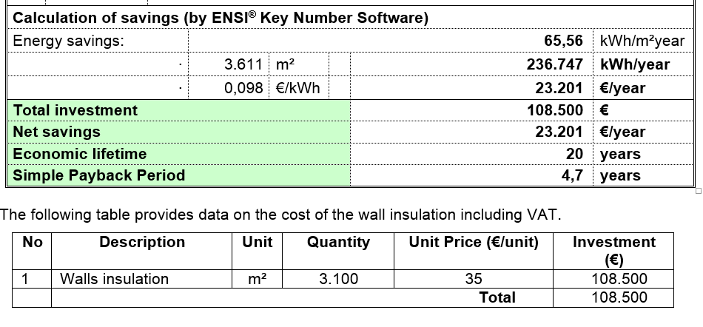
CALCULATION OF SAVINGS
INVESTMENT

Slide 13
EE Measures: Building’s envelope
Thermal insulation of the roof
This measure involves applying thermal insulation on flat or sloping roof surfaces, depending on the roof structure. More heat is lost through roof surfaces than through walls, which means that the thermal insulation of the roof, if of the same properties as the wall insulation, should be thicker than that applied on the walls. The correctly insulated roof surface can yield up to 25-40% of savings.

Slide 14
EE Measures: Building’s envelope
Replacing windows or improving their thermal characteristics
Windows are the segment of a building’s envelope that requires special attention. Heat losses through windows can be transmission or ventilation losses. These two types of heat losses combined can amount to more than 50% of the total heat losses of the building. Heat losses through windows are usually more than 10 times higher than those through the walls. That is why the windows are a very important segment that must be treated through efficiency measures.

Slide 15
EE Measures: Building’s envelope
Thermal insulation of the floor
Heat losses to the ground amount to up to 10% of the total heat losses of a building. When the ground floor of an existing building is concerned, it is not cost-effective to undertake its insulation due to a significant scope of works.
Thermal insulation of the ground floor is not the same as thermal insulation of the floor towards the unheated space of the lowest floor. In the latter case, the intervention is cost-effective, so that such a measure should be recommended. In addition, it is necessary to thermally insulate the floor structures above the open passages to ensure the continuity of thermal protection of the whole external envelope of the building.

