Slide 1
Training: Energy Audits
REEHUB Plus Project
Biljana Gligoric, architect, energy auditor Marija Vujadinovic, mechanical engineer, energy auditor

Slide 2
Biljana Gligorić, architect, energy auditor since 2009
Member of the Energy Efficiency Board with the Chamber of Commerce of Montenegro, Vice President (2009)
Member of the National Council for Sustainable Development, with the Government of Montenegro, since 2006 until 2012 (2 mandates)
Member of expert team for development Montenegrin National Strategy for sustainable development until 2030, 2016
Co-Writing and design of Manuel for Energy audits in Montenegro /with Marija Vujadinovic, Kulinovic/; 1/2012-12/2012, Client: Deutsche Gesellschaft für Internationale Zusammenarbeit(GIZ) GmbH;
National/Local energy expert for support development of the National energy software for building certification and energy audits (MEEC). Software is developed by The Fraunhofer Society from Germany.
Preparation more than 50 Detailed Energy audits and Energy reports.

Slide 3
Lessons
0-Auditi_introduction
1-Auditi_The purpose and types of a detailed energy audit
2-Auditi_Phase 1 Activities before the site visit
3-Auditi_Phase 2 Activities during the site visit
4-Auditi_Phase 3 Activities after the site visit - MEASURES – ENVELOPE
5-MV Auditi_Phase 3 Activities after the site visit - MEASURES HVAC_ELECTRO
6-Auditi_Phase 5 Calculation
7-Auditi_software-example MEEC

Slide 4
About Energy Audits
Energy audit of a building entails an analysis of the energy properties of the building envelope and its technical systems in order to establish the present energy consumption, and provide conclusions and recommendations for improving its energy efficiency.

Slide 5
These measures refer to:
Improving the thermal properties of the external envelope;
Replacing or improving the heating system;
Replacing or improving the ventilation system;
Replacing or improving the cooling system;
Replacing or improving the air conditioning system;
Replacing or improving the domestic (sanitary) hot water preparation system;
Improving the lighting system and the system of electric appliances (consumers);
Replacing fuel in cases when it is economically and environmentally cost-effective;
Introducing renewable energy sources;
Using water rationally;
Improving the control and management system.

Slide 6
All the proposed packages of measures include:
the data on the technical characteristics of the implementation of measures,
energy savings that can be achieved by them,
evaluation of investment, and
possible economic savings
Based on the comparison of the obtained results, a report is prepared with recommendations for an optimal selection of measures.

Slide 7
Types of energy audits
Depending on how detailed research is, there are two types of energy audits:
Preliminary energy audits
Detailed energy audits

Slide 8
It is important to note that each country has its legislative framework governing this area. It primarily refers to:
calculation methodology,
reference data on energy consumption,
climate characteristics,
and the minimum approved amounts of electrical and thermal energy consumption,
nationally approved software for the calculation of energy performance of buildings, etc.
Before undertaking an energy audit, you should acquaint yourself well with the national legislative framework so that the detailed energy audit you perform is valid.
Detailed energy audits are always carried out by authorized persons.

Slide 9
Phases of the detailed energy audit
An energy audit can begin after signing a contract with the energy audit client, defining, among other things, the goal and scope of the audit.
All the activities related to energy audit can be divided into three phases:
Phase 1: Activities before the site visit
Phase 2: Activities during the site visit
Phase 2: Activities after the site visit

Slide 10
Phase 1: Activities before the site visit
Step 1 Initial meeting with the energy audit client
An energy audit begins with an initial meeting with the energy audit client, during which the client is acquainted with the activities to be carried out as part of the planned energy audit. For an auditor to be prepared for the site visit and to form a first picture of the building and its energy performance, the client should provide the following data/documents:
The existing technical documentation;
Data about energy and water consumption in the building, i.e., the copies of bills for all consumed fuels and water (preferably for the 3 last years, and at least for last 12 months);

Slide 11
When technical documentation for the existing building is not updated or is completely missing, the auditor should use the present documentation and subsequent visual survey, possible measurements, and photo documentation to make assumptions important for further analyses. It might be useful if the building is built in a typical style so that necessary information can be obtained from the data on another building of the same type.

Slide 12
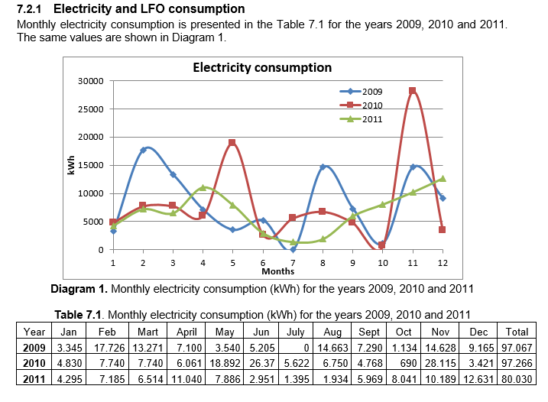
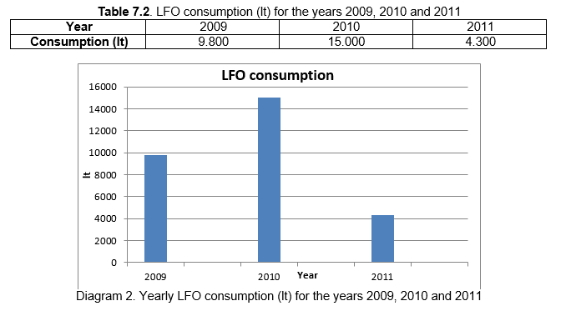

Slide 13
The analysis of energy and water consumption based on the available bills is very important in order to compare the consumption and energy needs of the building determined by calculation. For that purpose, it is necessary to establish referential annual energy or water consumption.

Slide 14
Make a plan of visit and plan of necessary measurements to be carried out;
Prepare the necessary instruments and equipment for carrying out the planned measurements: thermometer, temperature data logger, lux meter, thermographic camera, flue gas analyzer, anemometer, ultrasonic flow meter, network analyzer, etc.;
You should also bring a meterstick, a long tape measure, etc. (especially in cases when the project documentation is missing);
Don't forget the camera! Prepare the camera, making sure it is set to the highest resolution to get the best quality photos, the card has enough memory, the battery is charged, etc.

Slide 15
Phase 2: Activities during the site visit
Step 5 Survey of the existing state of the building
The site visit aims to provide:
more information about activities in the building,
engineering and energy characteristics of the building,
how the building is managed and maintained, and
the occupants’ habits.

Slide 16
Photo documentation collected during the site visit is very important for preparing a report on the energy audit in the best possible way.
In addition, photo documentation is of great help in later additional analyses and surveys of details of the building’s technical characteristics.

Slide 17
External walls
Identify layers of the wall and their thickness;
Establish if there is thermal insulation and indicate its type;
Record all types of walls and their orientations;
Establish if there are any damages to the walls and record them;
Record all fasteners, girders, canopies, awnings, ...;
Establish if there are any places damaged by water penetration
Identify any specific stylistic and other details on the facade;
Identify any specific design elements (bay windows, drains, brackets, curved surfaces, passages, etc.);
Check the parapet walls, if their thickness is reduced, materials changed, etc.;
Identify all cold (thermal) bridges (linear and point thermal bridges)

Slide 18
Roof
Establish if there is waterproofing and if it is adequate;
Establish if there are any damages in the building caused by water penetrating from the roof;
Indicate the type (lying, hanging) and state of gutters and vertical pipes;
Establish if there is an attic (if the roof is flat)
Analyze the junction between the roof and wall plane;
Identify all penetrations through roof surfaces (vertical chimney, various girders, etc.);
Identify if there are roof windows, skylights, etc.
Identify all types of roof (flat or sloping);
Identify the roof structure;
Identify layers of each roof’s type and their thickness;
Establish if there is thermal insulation and indicate its type;
Establish if a roof is passable (in case of a flat roof);
Establish if there are any damages to the roof and describe them;
Record how the atmospheric water drainage is solved and note any damages;

Slide 19
Windows and doors
Identify all types of windows and their orientation;
Divide windows into different types if they differ in dimensions, kinds, number and thickness of glasses, frame material, type of frames, type of windows, type of sun shading ;
Record the state of windows according to their types, with brief descriptions;
Mark in the sketch the windows with damages and describe the damage;
Mark the windows in a way that it is clear what measures will be proposed for each type of window;
Mark the windows that fulfill thermal requirements;
Identify the recently replaced windows ;
Identify all kinds of sun shading and their characteristics

Slide 20
Floor
Identify all types of floors (depending on their finishing and layers);
Check actual and constructed surfaces according to floor types;
Establish if there is thermal insulation

Slide 21
Heating system
Make a note of the data on the boiler plate;
Describe the condition of boiler, its casing, insulation, installations;
Describe the condition of safety equipment;
Make a note of the data from the burner plate;
Describe the condition of the chimney and the connection to chimney;
Check if chemical treatment of water exists;
Indicate the temperature regime of the heating system;
Provide information about the boiler room and mark its position in the drawings/sketches

Slide 22
Heating system
Indicate the type of fuel and how it is supplied;
Make a note of the data from the nameplates of the fuel storage and the fuel supply system;
Describe the condition of installations for the fuel storage and supply;
Describe the condition of safety equipment for the fuel storage and supply;
Determine the fuel consumption based on the tank filling data

Slide 23
Heating system
Describe the general condition of pipework and fittings;
Describe the condition of pipeline insulation;
Provide information on circulating pumps and their regulation;
Check if the hydraulic balancing of the system exists
Specify the type of heating emission bodies, their total number and installed heating capacity by types, and mark their locations in the drawings/sketches;
Describe the condition of heating emission bodies
Check if the heating emission bodies have regulation valves

Slide 24
Heating system
Indicate the type of the regulation system and it’s compatibility with the heating system, i.e., characteristics of the building;
Establish if there are zones with different heating temperatures;
Record the locations of temperature sensors;
Make a note on possibility of monitoring of physical quantities to be regulated

Slide 25
Heating system
Specify the regime of operation of the heating system (on/off, set-back temperature);
Describe the maintenance of the system;
Check if the consumption of fuel and delivered energy is monitored;
Check the availability of the documentation for the boiler and its equipment, as well as the connection schemes;
Check if there is a book on boiler inspection and maintenance;
Register the data on periodic inspections if they exist

Slide 26
Heating system
Check if there are individual heating appliances in the building;
Specify the types, number, installed capacity, operating mode, and general condition of the individual heating appliances in the building

Slide 27
Ventilation system (heating)
Specify the data about the ventilated space (description and size);
Provide information about the requirement for air exchange and quality (temperature, humidity);
Make a note of the data on the air handling unit plate (number of units, type, year of production, total installed electrical power and capacity of the system);
Mark the location of the air handling units in the drawings/sketches;
Describe the condition of the air handling unit

Slide 28
Ventilation system (heating)
Specify the type and capacity of the air heater;
Describe the condition of the air heater
Indicate the source of thermal energy used by the air heater (data from the boiler nameplate);
Describe the state of the boiler, the casing, insulation, installations;
Provide information on circulating pumps (type, power, condition) and their regulation;
Check if there are filters, humidifiers, cooling coils and specify their type and capacity;
Provide information about fans (type, power, condition) and their regulation

Slide 29
Ventilation system (heating)
Describe the ductwork (material, cross-section, insulation);
Describe the condition of ductwork;
Indicate if there are regulating flap valves;
Identify the elements for air distribution (grilles, diffusers, etc.);
Identify the inlets for fresh air supply and the outlets for the exhaust air discharge;
Indicate the proportion of fresh air;
Indicate the quantity and temperature of the exhaust air;
Indicate the quantity and temperature of the supplied air;
Check if air recirculation is used;
Check if there is a heat recovery system and indicate its type and efficiency;
Describe the regulating system and its condition;
Make a note on possibility of monitoring of physical quantities to be regulated

Slide 30
Ventilation system (heating)
Indicate the regime of operation of the ventilation system;
Describe the maintenance of the ventilation system;
Indicate the age of the system and its general condition

Slide 31
Cooling/air conditioning system
Indicate the type of cooling/air conditioning system (local or central)

Slide 32
Local cooling system
Specify the type of system (mono-split, multi-split, compact units);
Specify the number of units (indoor and outdoor) and mark their locations in the drawings/sketches;
Indicate the total installed cooling capacity;
Specify individual cooling capacities;
Check if there is an option for heating as well;
Specify the average cooling/heating factor (EER/COP);
Specify the type of cooling agent;
Describe the regulation of the cooling system;
Indicate the regime of operation of the cooling system (on/off);
Describe the maintenance of the system;
Indicate the age of the system and its general condition

Slide 33
Central cooling system
Specify the total installed cooling capacity;
Specify the type of chiller (compressor or absorption);
Specify the number of chillers and mark their locations in the drawings/sketches;
Make a note of the data on the chiller’s nameplate (type, power, efficiency, temperature regime);
Specify the type of refrigerant;
Specify the age and describe the condition of the chiller;
Specify the energy source used by the chiller;
Check if there are cooling towers (specify their number and mark their location in the building);
Check if free cooling is used;
Check if evaporative cooling is used (specify airflow, saturation effectiveness);
Check if the availability of the heating option

Slide 34
Central cooling system
Check if there is a heat pump (specify the source and sink, number of pumps and their locations in the building);
Make a note of the data on the heat pump nameplate (type, cooling/heating capacity, EER/COP);
Specify the age and describe the condition of the heat pump

Slide 35
Central cooling system
Establish Check if the presence of air conditioning chambers air handling unit exists (specify indicate the number of units chambers, type, year of production, total installed electric power and capacity of the system);
Establish Check if there are the presence of filters, humidifiers, heaters, cooling coilers and specify their type, capacity, and energy source;
Provide information on circulating or pumps (type, power, condition) and their regulation how they are regulated;
Provide information about ventilators fans (type, power, condition) and how they are regulated their regulation;
Establish Check if there is a heat recovery system and state specify the type and efficiency of the system;
Mark in drawings/sketches the location of the air conditioning chamberair handling unit within the building;
Describe the state condition of the air conditioning chamberair handling unit

Slide 36
Central cooling system
Specify the type of energy carrier (water, air);
Describe the ductwork (cross-section, material, insulation, regulating flap valves);
Describe pipe distribution (two-pipe or four-pipe, the material, insulation);
Specify the age and describe the condition of the duct/pipe distribution;
Identify terminal units (specify their type, number, installed power, and mark their locations in drawings/sketches)

Slide 37
Central cooling system
Describe the regulation system of chillers and terminal units;
Check if there are zones with different cooling temperatures;
Make a note on possibility of monitoring of physical quantities to be regulated
Indicate the regime of operation of the cooling system;
Describe the maintenance of the cooling system

Slide 38
System for domestic hot water (DHW) preparation
Indicate how DHW is prepared (decentralized, central system)

Slide 39
Decentralized DHW preparation
Specify the type of device (storage or flow heater), number, type of fuel, total capacity, and capacity by types;
Specify the amount of water consumed in the building;
Specify the water consumption locations in the building (type and number, the way of use and number of uses);
Specify the operating regime of the device;
Describe how the device is maintained;
Indicate the age of the device and describe its condition;e how DHW is prepared (decentralized, central system)

Slide 40
Central DHW preparation
Specify the heat source (existing boilers used for heating of the building, separate DHW boilers);
Make a note of the data on the boiler nameplate;
Describe the condition of the boiler, casing, insulation, installation;
Make a note of the data on the tank nameplate (volume, etc.);
Describe the condition of the tank and the insulation;
Describe the pipe distribution system (material, insulation);
Check if there is a leakage in the system;
Specify the temperatures of water (hot/cold);
Check if the hot water consumption is measured;
Describe the regulation of DHW preparation system;
Specify the quantity of water consumed in the building;
Specify the water consumption locations in the building (type and number, the way of use and number of uses);
Specify the regime of operation of the system;
Describe the maintenance of the system;
Indicate the age of the system and describe its condition;

Slide 41
An electric power system and consumption measuring
Check the condition of the main distribution cabinet in the building, and the local distribution cabinets;
Make a note of the results of IR camerawork of the distribution cabinets which indicate the unwanted heating of cables, circuit breakers, fuses, and other elements;
Indicate the type, cross-section, and state of the main electrical power cable;
Indicate the age of installations, the latest date when the electrical installation system or its parts were repaired or reconstructed;
Indicate the voltage level, location, and method of power supply of the building;
Establish if regular maintenance is carried out and if the contracts for maintenance of electrical installations in the building exist;

Slide 42
An electric power system and consumption measuring
Establish if a certificate of proper functioning of electrical installations has been issued in the last three years;
Indicate the place of measurement, and the voltage level;
Specify the method of measurement (direct or indirect);
Check if the consumed reactive energy and power demand have been measured;
Indicate the type, manufacturer, and serial number of the meter;
Indicate the current phase and intermediate voltages in the main distribution cabinet, and the phase currents in the main power cable (measured by a clamp meter);
Check if there is a device for reactive power compensation in the building;
Check if there is a system for peak power management the building

Slide 43
Lighting system (indoor and outdoor)
Specify the type and number of luminaries, their individual and total installed power;
Describe the condition of luminaries and indicate their age;
Specify the kind of ballasts used in fluorescent lamps (magnetic or electronic);
Indicate the method of lighting control (central, local, automatic);
Check if there are any timers, impulse relays, light sensors, presence sensors/motion sensors, etc.
Check if there is an intelligent control system and if the lighting is integrated into a “smart house” system (in case it is used in the building);
Check if the lighting system in the building is regularly maintained;
Check if the maintaining illuminance meets the standards for that type of building;
Describe how the outdoor lighting is managed;
Indicate the regime of use of indoor and outdoor lighting (daily, weekly, annual)

Slide 44
System of other electric appliances
Specify the type of appliance, and its manufacturer;
Specify the declared energy class of each appliance;
Specify the number of appliances, their individual and total installed capacity;
Assess the impact of appliances on the thermal balance of the building and divide them into two groups: appliances that do and appliances that do not affect the thermal balance of the building;
Specify the age, i.e., the year of production of appliances;
Describe the condition of appliances;
Describe how the appliances are regulated;
Specify how many hours the appliances are used per day, on average, and how many days during the year;
Check if there is an intelligent appliance control system and if the appliances are integrated into a “smart house” system or a peak power control system, if such systems are used in the building;

Slide 45
Drinking and domestic water supply system
Indicate the water consumption locations in the building (type and number, the ways of use and number of uses);
Check if water is consumed by certain technical systems in the building (e.g., cooling towers, humidifiers, etc.);
Describe how drinking water is supplied;
Describe the condition of the water supply system and network;
Record possible losses and unwanted leakages;
Check if there is a pressure regulation system;
Check if there is a hydrant network, describe its condition and potential losses;
Describe the maintenance of the system

Slide 46
Specific subsystem: Compressed air system
Indicate the purpose of the system;
Provide information about compressors (type, manufacturer, number, age);
Specify the total capacity and individual capacities;
Specify the operating pressure in the network;
Specify the operational parameters of the compressor;
Indicate the installed electrical power of the electric motor per compressor;
Provide the data about the compressed air tank (volume, number)
Describe how the system is regulated;
Describe how the compressor is cooled;
Specify the operating regime of the system;
Describe the general condition and efficiency of the system

Slide 47
Step 6 Carrying out the necessary measurements
The measurement plan must answer the following questions:
Who performs the measurement?
Where is the measurement carried out?
How long does the measuring take?
Who, on the part of the users, approved the measuring?
What equipment is used for measurement?
Who controls the measurement?

Slide 48
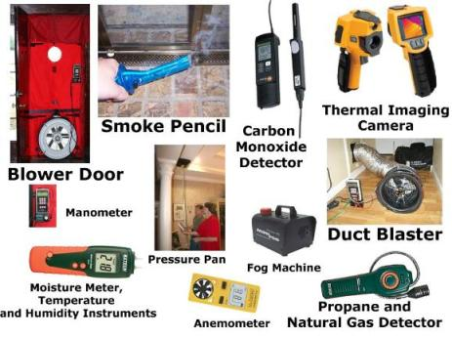
Step 6 Carrying out the necessary measurements

Slide 49
Phase 4: Activities after the site visit
After visiting the site, the auditor needs to examine all the data obtained from the activities during the preparation and building survey phases, upon which he/she

Slide 50
Analysis of thermal characteristics of the building’s external envelope
Analysis of energy characteristics of the heating system
Analysis of energy characteristics of the air conditioning and cooling systems
Analysis of energy characteristics of the system for preparation of domestic hot water
Analysis of energy characteristics of the electricity appliances/consumers
Analysis of energy characteristics of the systems for producing thermal and electrical energy from alternative energy systems
Calculating the amount of thermal energy required for heating
Analysis of domestic water consumption

Slide 51
Step 7 Analysis of the collected data
>>> SOFTWARE FOR ENERGY PERFORMANCE CALCULATION
>>> CALCULATION

Slide 52
EE Measures: Building’s envelope
Thermal insulation of external walls
This measure is always implemented when external walls are without any thermal protection. Savings by introducing this measure can range from 15-25%. In addition to thermal protection, this measure prevents the negative consequences of cold bridges and significantly improves the indoor comfort.

Slide 53
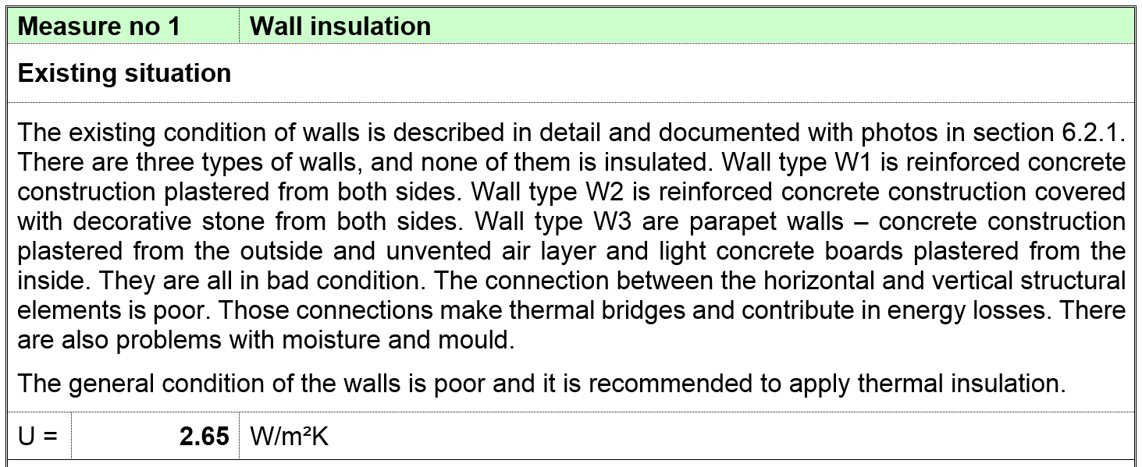
example: Thermal insulation of external wall or a wall adjacent to an unheated space

Slide 54
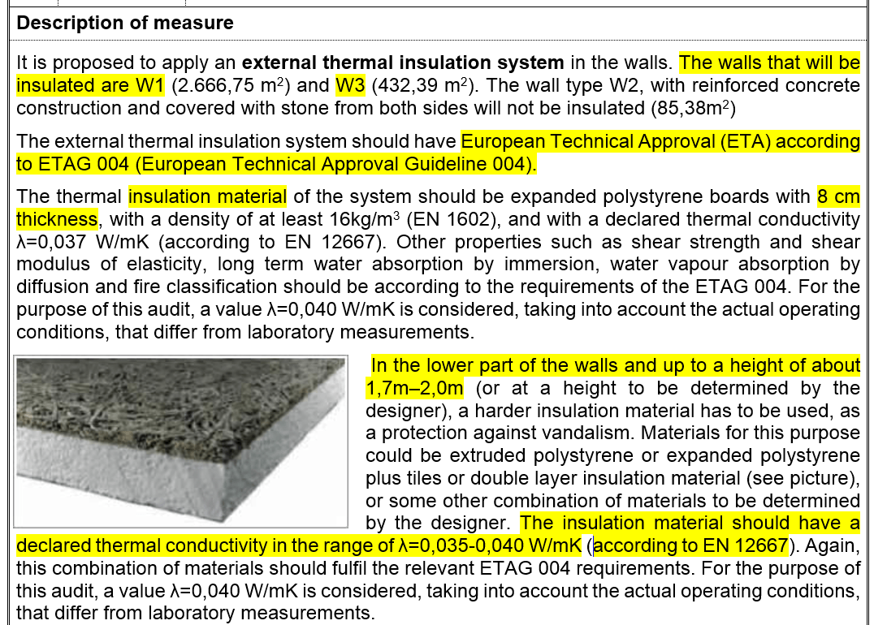
POSTITION
STANDARD
TYPE OF INSULATION
DESCRIPTION
DRAWINGS/IMAGES
THERMAL CHARACTERISTICS

Slide 55
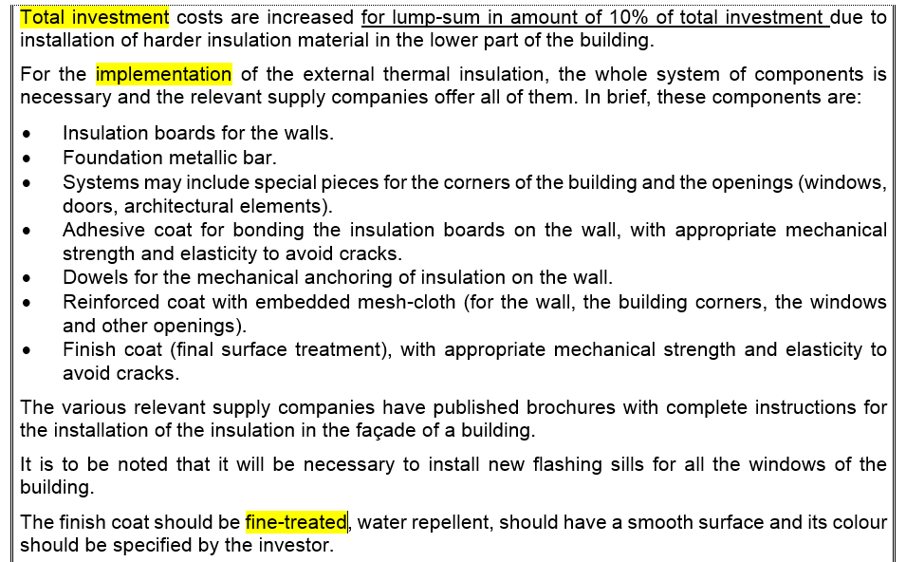
INVESTMENT
IMPLEMENTATION
SYSTEM / LIST OF COMPONENTS
MAINTENANCE

Slide 56
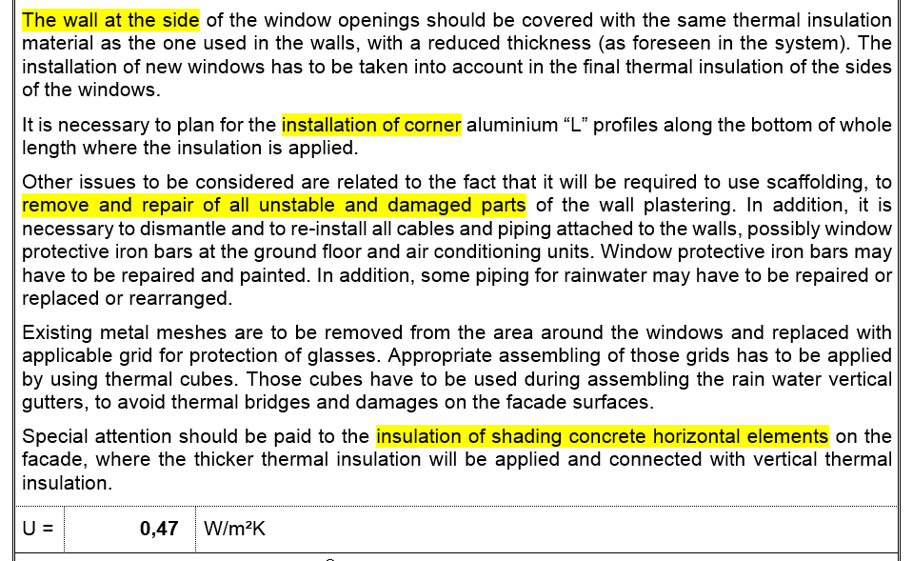
INSTALATION - NOTES
NEW U VALUE

Slide 57
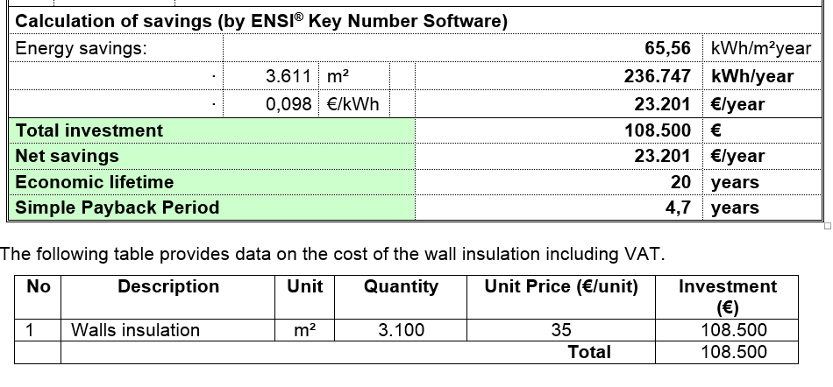
CALCULATION OF SAVINGS
INVESTMENT

Slide 58
EE Measures: Building’s envelope
Thermal insulation of the roof
This measure involves applying thermal insulation on flat or sloping roof surfaces, depending on the roof structure. More heat is lost through roof surfaces than through walls, which means that the thermal insulation of the roof, if of the same properties as the wall insulation, should be thicker than that applied on the walls. The correctly insulated roof surface can yield up to 25-40% of savings.

Slide 59
EE Measures: Building’s envelope
Replacing windows or improving their thermal characteristics
Windows are the segment of a building’s envelope that requires special attention. Heat losses through windows can be transmission or ventilation losses. These two types of heat losses combined can amount to more than 50% of the total heat losses of the building. Heat losses through windows are usually more than 10 times higher than those through the walls. That is why the windows are a very important segment that must be treated through efficiency measures.

Slide 60
EE Measures: Building’s envelope
Thermal insulation of the floor
Heat losses to the ground amount to up to 10% of the total heat losses of a building. When the ground floor of an existing building is concerned, it is not cost-effective to undertake its insulation due to a significant scope of works.
Thermal insulation of the ground floor is not the same as thermal insulation of the floor towards the unheated space of the lowest floor. In the latter case, the intervention is cost-effective, so that such a measure should be recommended. In addition, it is necessary to thermally insulate the floor structures above the open passages to ensure the continuity of thermal protection of the whole external envelope of the building.

Slide 61
EE Measures: Heating systems
Replacing old conventional boilers with biomass–pellets boilers
Replacing old conventional boilers with heat pumps that use air, ground, or groundwater as a heat source
Fitting thermostatic valves to the existing heaters
New automatic regulation system
Thermal insulation of the non-insulated parts of the system
Setback temperature

Slide 62
Energy performance calculation

Slide 63
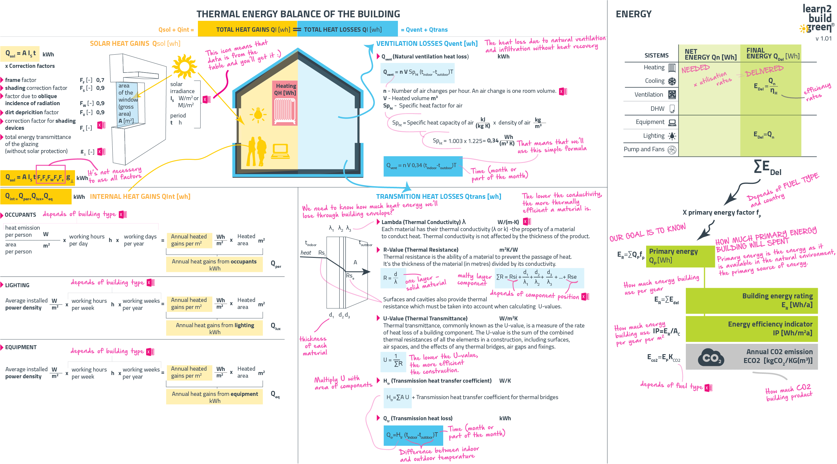

Slide 64
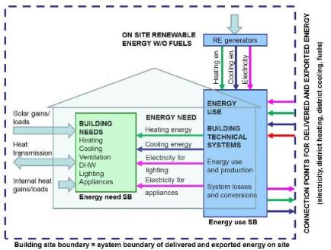
Methodology for calculation of energy performance of buildings
Directive on the energy performance of buildings (EPBD):
2002/91/EC
2010/31/EU (recast)
2018/844/EU (amendment)

Slide 65
Software MEEC (Montenegrin Energy Efficiency Certification)

Slide 66
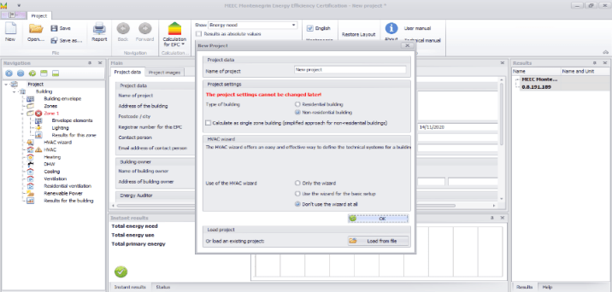
MEEC: Main concepts
Zone approach
Multi-zone approach (non-residential)
Single-zone approach (residential and non-residential)
HVAC system
HVAC wizard (simplified approach)
HVAC wizard but developing more details
Detailed description (no HVAC wizard use)

Slide 67
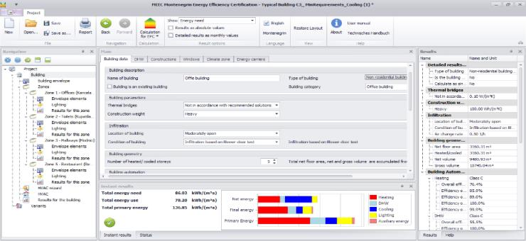
MEEC: User interface
Main area
Navigation tree
Help / Parameters results
Instant results

Slide 68
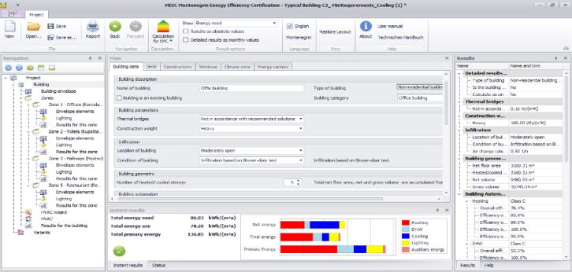
MEEC: Menu structure
Two modes
Certification
Consultation mode/ Energy audits

Slide 69
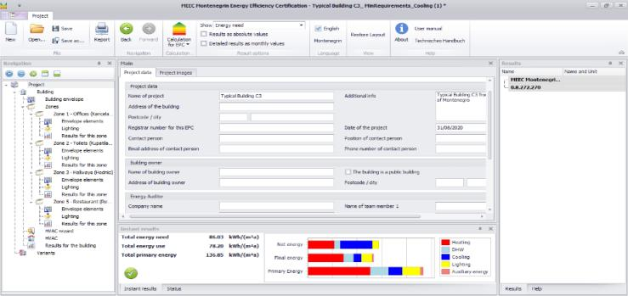
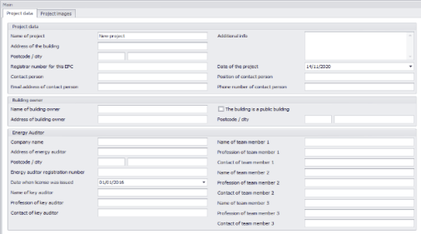
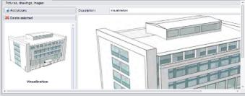
STEP 1: Definition of project data, energy auditors, etc.

Slide 70
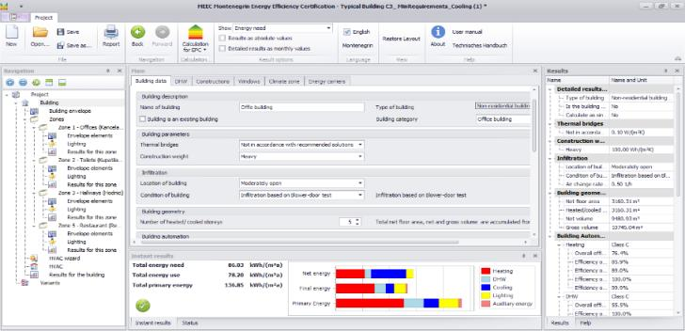
STEP 2: Definition of building data (1)
Building parameters in line with Rulebook on minimum energy efficiency requirements in buildings (methodology)

Slide 71
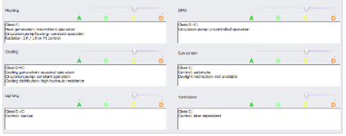
STEP 2: Definition of building data (2)
Automation levels of building systems described in 4 classes, A to D

Slide 72
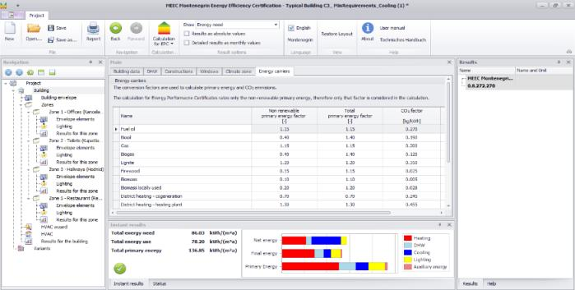
STEP 2: Definition of building data (3)
DHW demands
List of all user defined constructions
List of windows used in the project
Conversion factors
Climate data

Slide 73
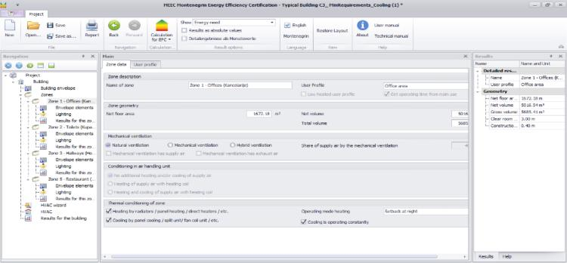
STEP 3: Definition of building zones (in case of multi-zone approach) (1)
Single zone approach:
13 user profiles defined for building types specified in the Rulebook
Multi zone approach:
36 user profiles defined for different zones (consistent with profiles for building types)

Slide 74
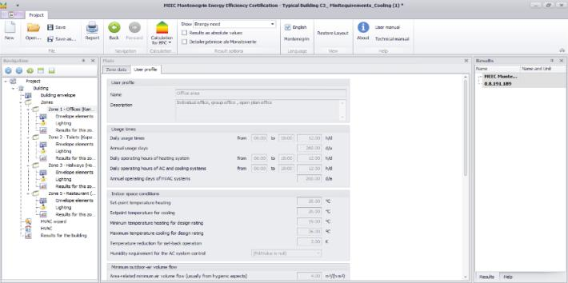
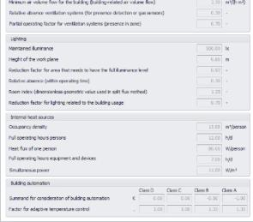
STEP 3: Definition of building zones (in case of multi-zone approach) (2)
Certification mode:
User profile data are “locked”.
Consultation/energy audit mode:
User profile data can be modified.

Slide 75
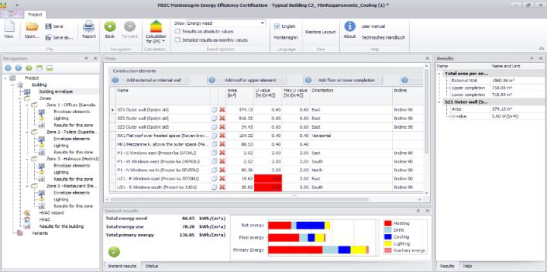
STEP 4: Definition of building envelope elements (1)
U-values exceeding the minimum requirements from the Rulebook are marked in red

Slide 76
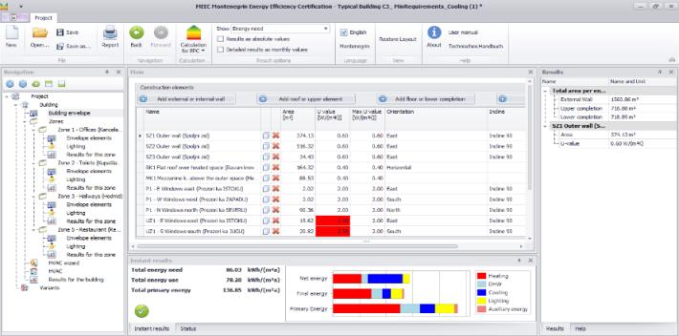
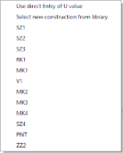
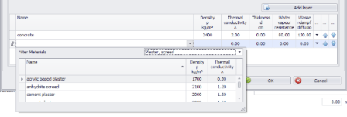
STEP 4: Definition of building envelope elements (2)
Opaque envelope elements
Direct U-values entry
Definition of construction layers

Slide 77
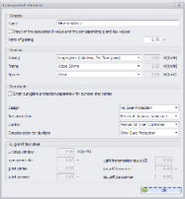
STEP 4: Definition of building envelope elements (3)
Transparent envelope elements
Direct U-value entry (and corresponding g and tau values)
Definition of window elements (glazing, frame, spacer)
+ definition of sun protection system

Slide 78
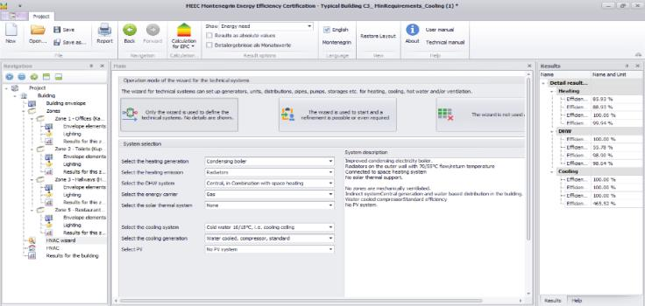
STEP 5: Definition of technical systems in building (1)
If only HVAC wizard is used no entries in the navigation tree are shown (default values for the selected systems)

Slide 79
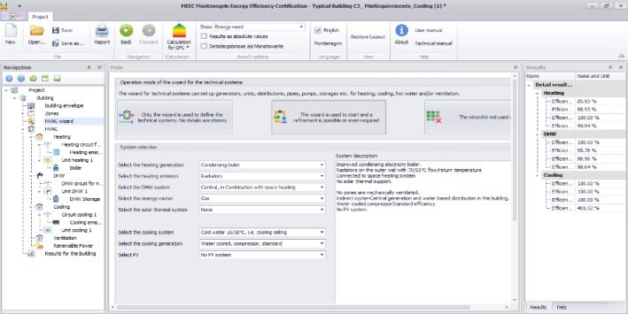
STEP 5: Definition of technical systems in building (2)
If HVAC wizard is used to start but with refinement possibilities, the details of the HVAC systems can be seen in the navigation tree and changes can be made

Slide 80
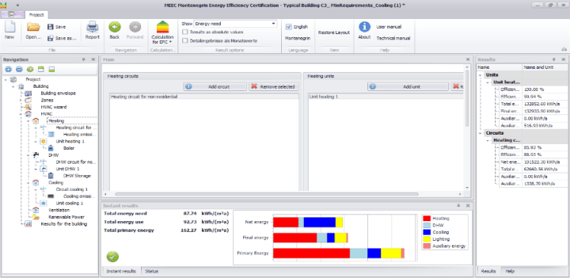
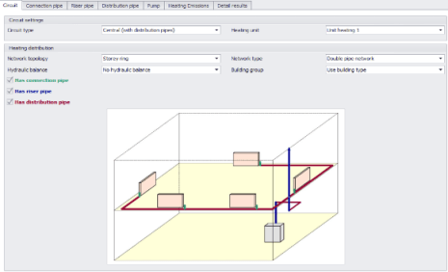
STEP 5: Definition of technical systems in building (3)

Slide 81
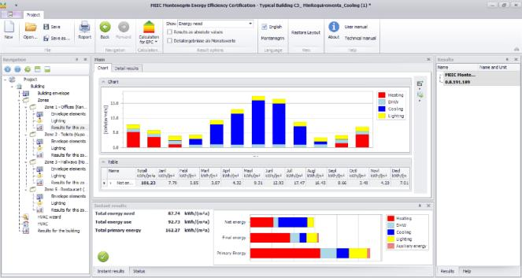
STEP 6: Display of the results

Slide 82
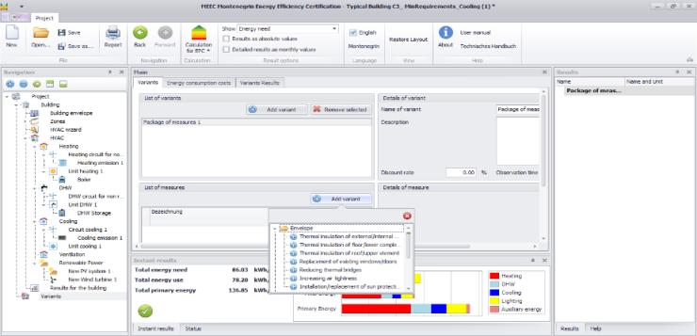
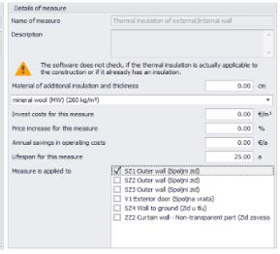
STEP 7: Definition of measures to improve energy efficiency of the building
EE measures:
Envelope
Lighting
HVAC – Heating
HVAC – DHW
HVAC – Cooling
HVAC – Ventilation
Power generation

Slide 83
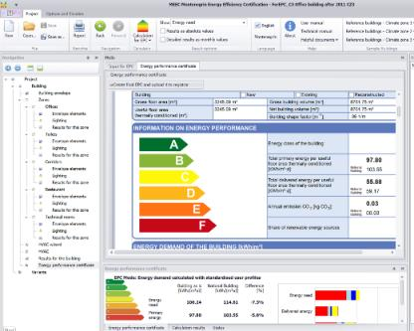
STEP 8: Generation of energy performance certificate (EPC)
* Calculation for EPC mode

Slide 84
PRIMER – STARA ZGRADA OPSTINE TIVAT
MEEC – PRIMER ZGRADA FAKULTETA

